Slide 1


Slide 2
How to Register for FLMS

Slide 3
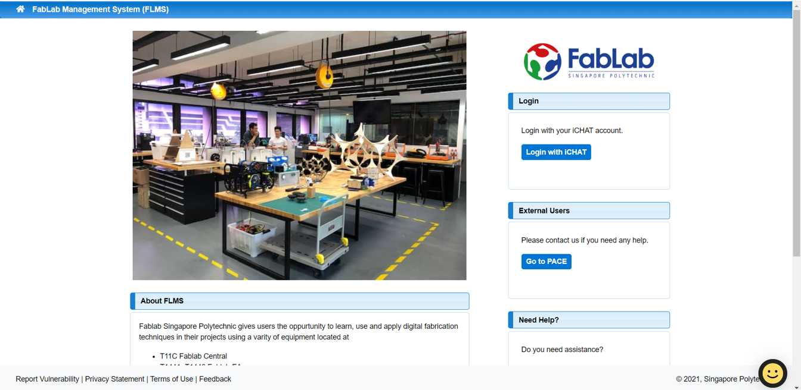
Step 1
Go to FabLab Management System and log in with you iChat account.

Slide 4
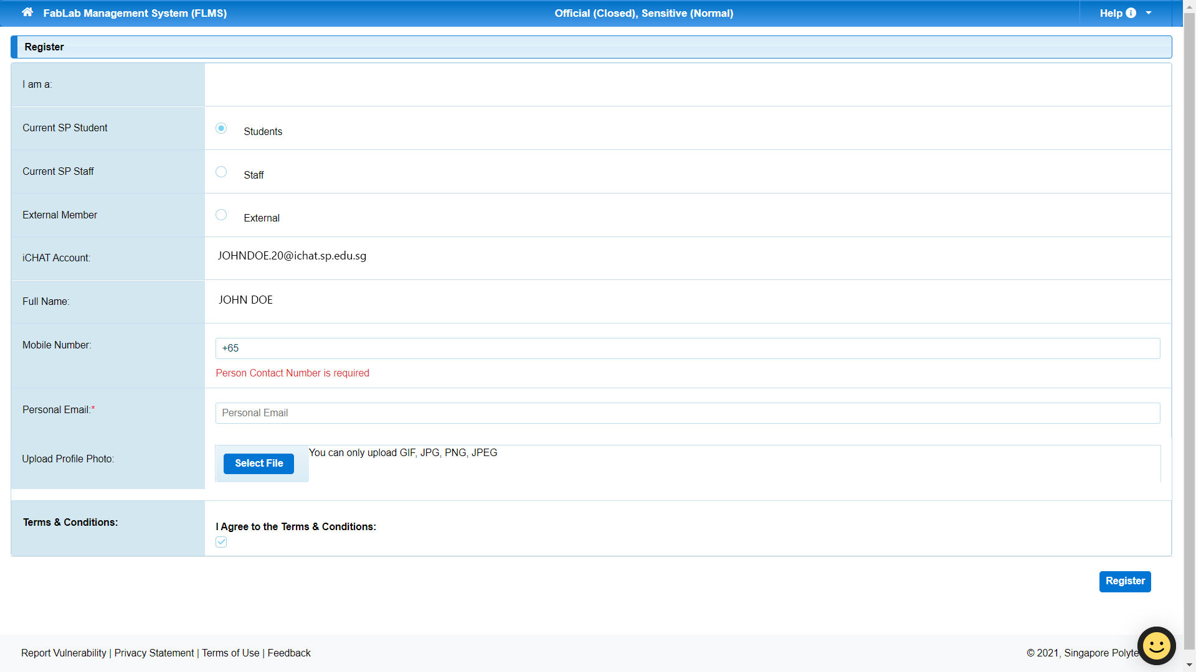
Step 2
This will take you to the registration page. Your full name and the iChat account will be automatically filled in. You will need to fill in your Mobile Number and Personal Email. For the profile picture, you will need to put your registered photo so that we can identify you when you come to the lab. You can find your photo at
e-services -> Personal -> My Info. You can also upload the photo after you have registered. The step-by-step guide will be stated later.

Slide 5
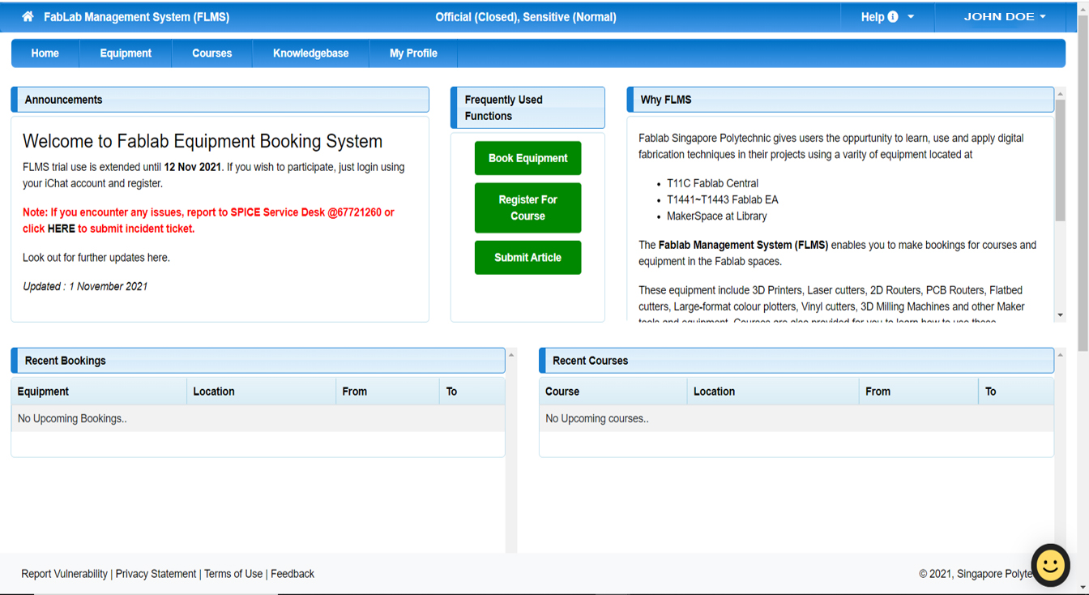
Step 3
Now you will be taken to the FLMS Homepage. You have successfully registered.

Slide 6
How to upload Profile Picture

Slide 7
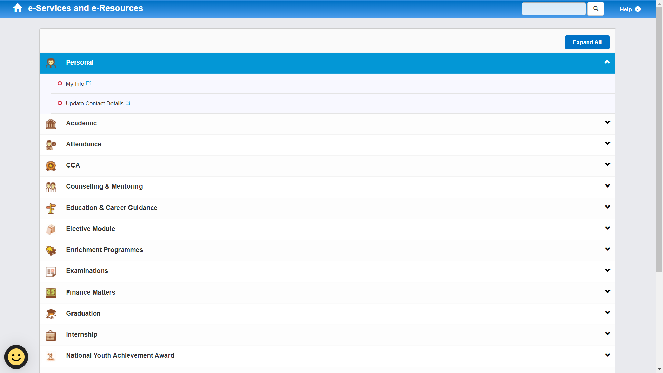
Step 1
Go to e-services->Personal->My Info. Then download your registered photo. Right click on the photo and click “Save image as”.

Slide 8
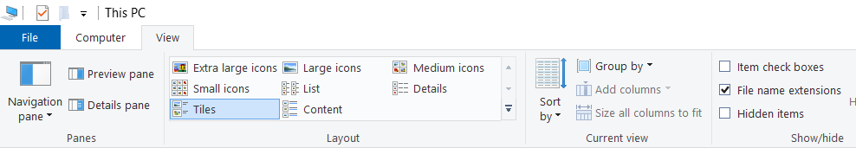
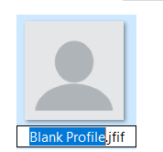
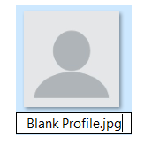
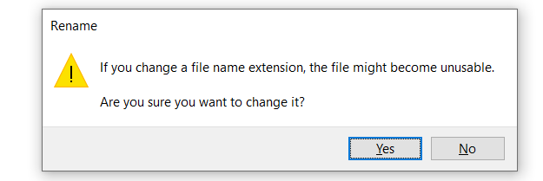
Step 2
The file is downloaded as “jfif” format. You will need to change it to “jpg” format. Before changing, make sure you have ticked “File name extensions” under “View” tap in order to see the file format.
After changing the file format, a warning will pop-up, click “Yes”.
1
2
3
4

Slide 9
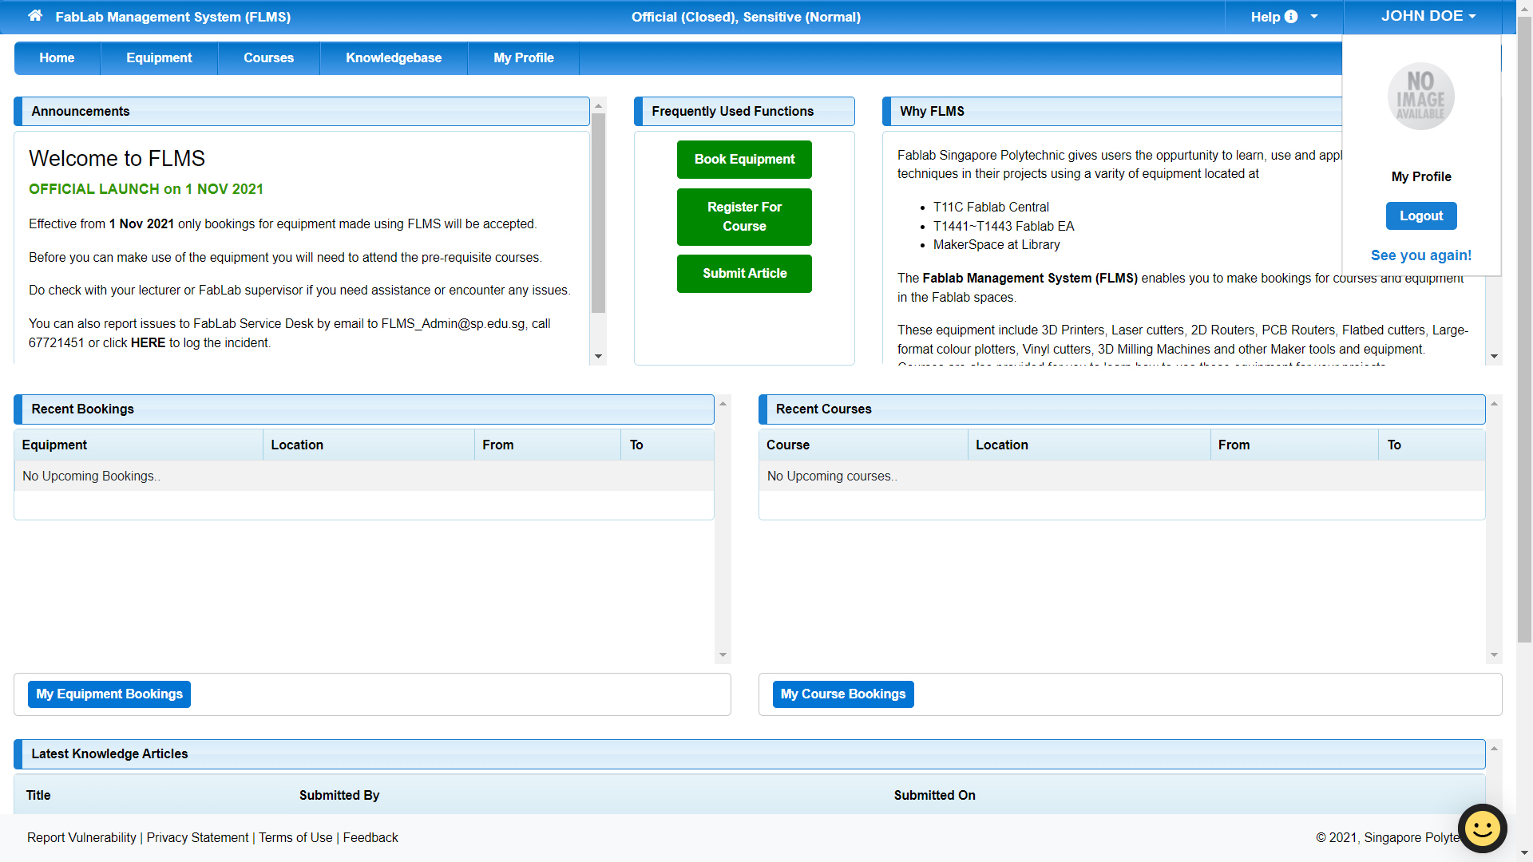
Step 3
Go to FabLab Management System home page and click on your username at the top right. A drop-down will show up. Click “My Profile”.

Slide 10
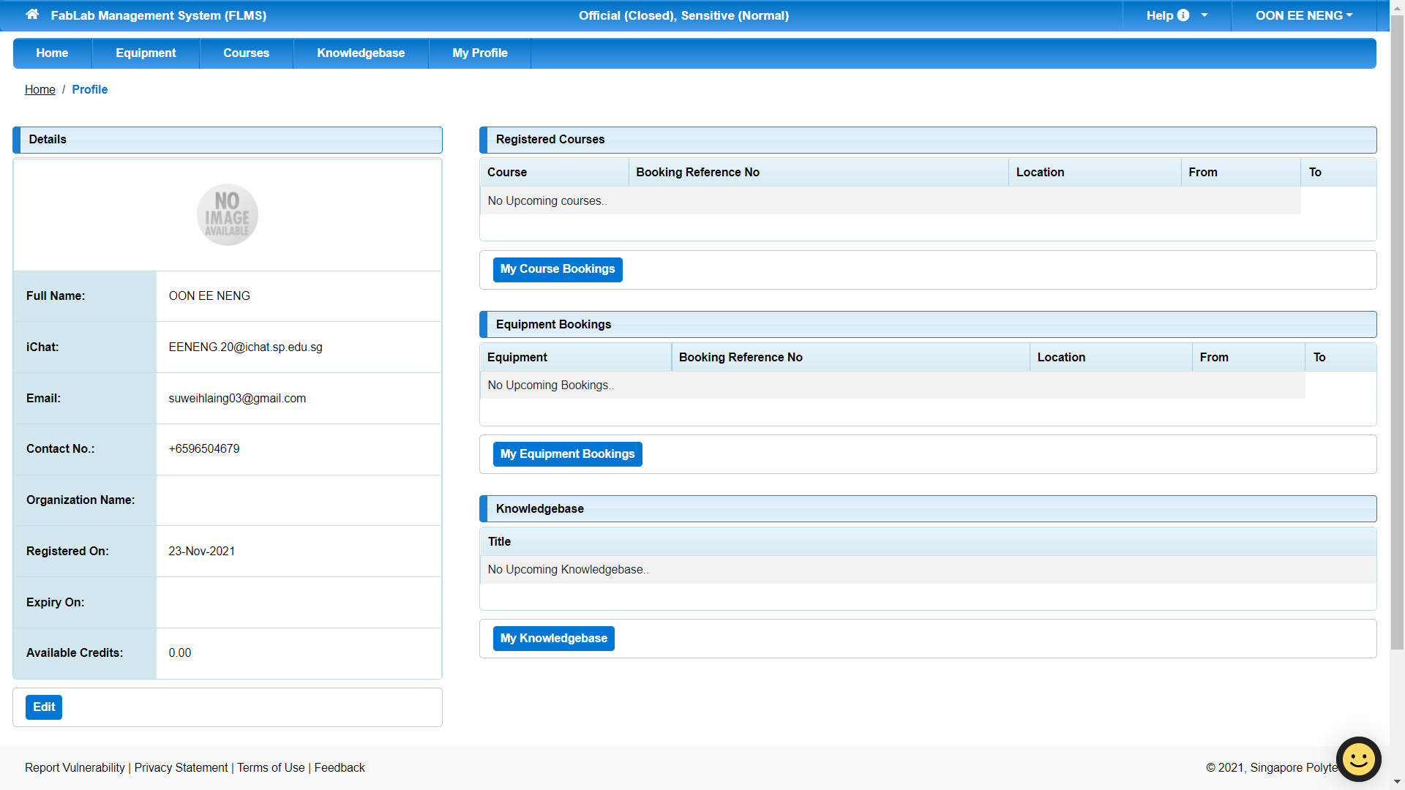
Step 4
In your profile page, click “Edit” at the bottom left of the screen.

Slide 11
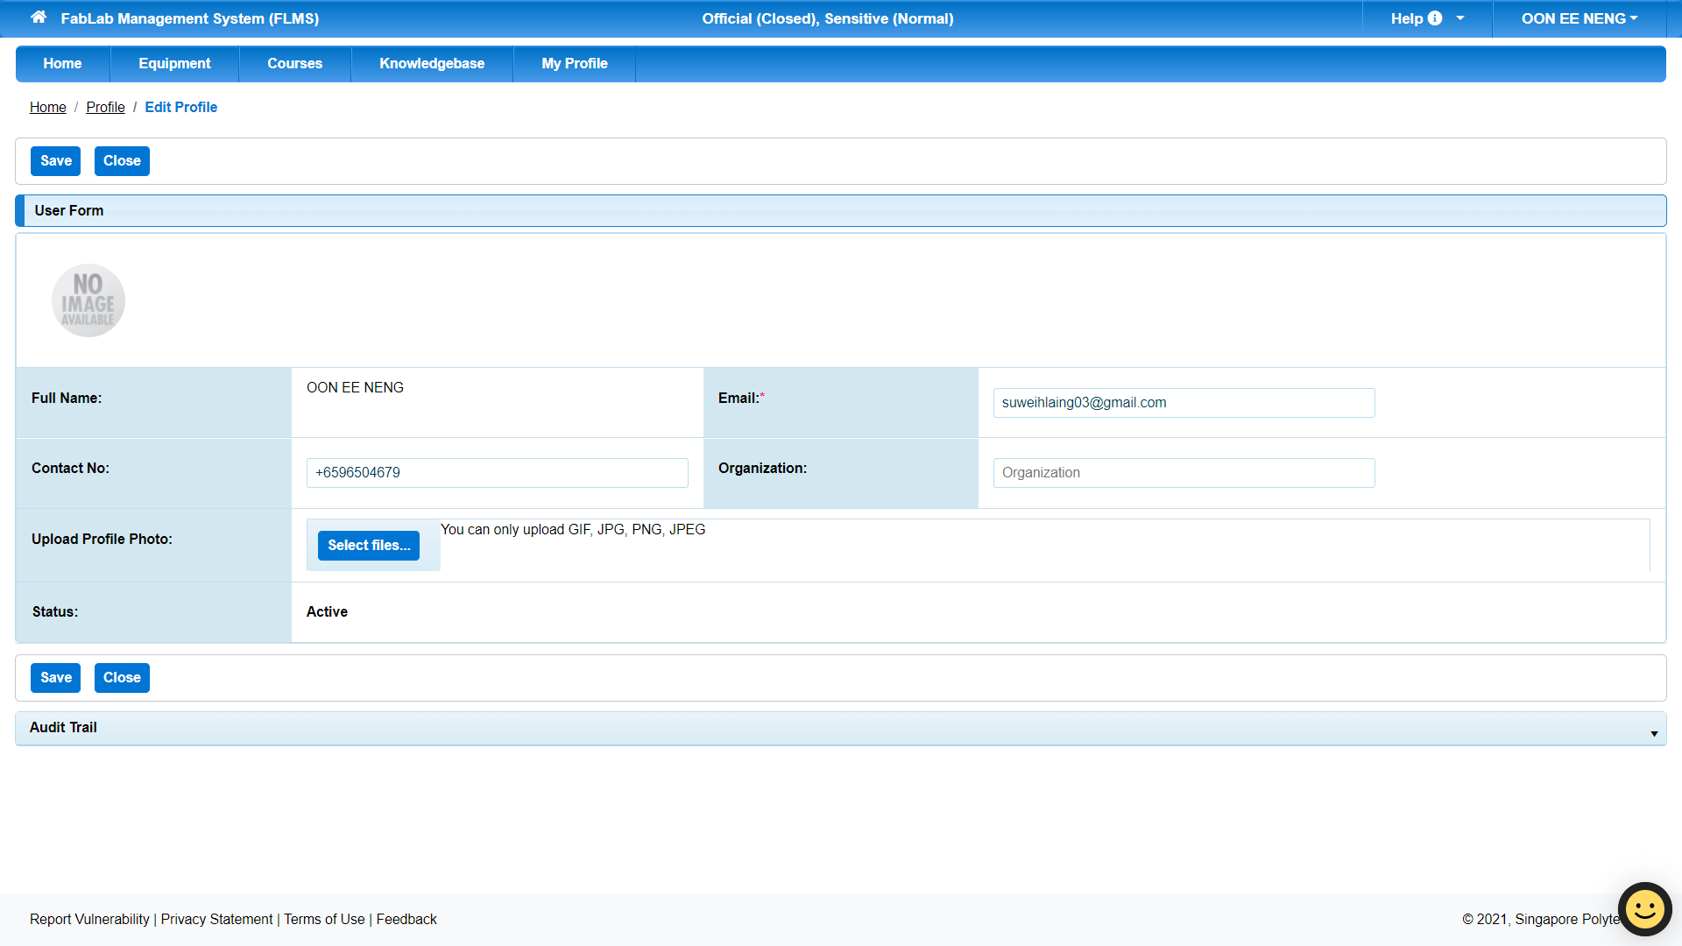
Step 5
Click “Select files…” and select your registered photo. Make sure the file is in one of the formats stated. Otherwise, the system will not accept the photo. After this, click “Save”.

Slide 12

Step 6
You can see that the profile photo has changed in the details table.

Slide 13
How to Book a Course

Slide 14
Step 1
Go to FabLab Management System Home page and click Book Equipment.

Slide 15
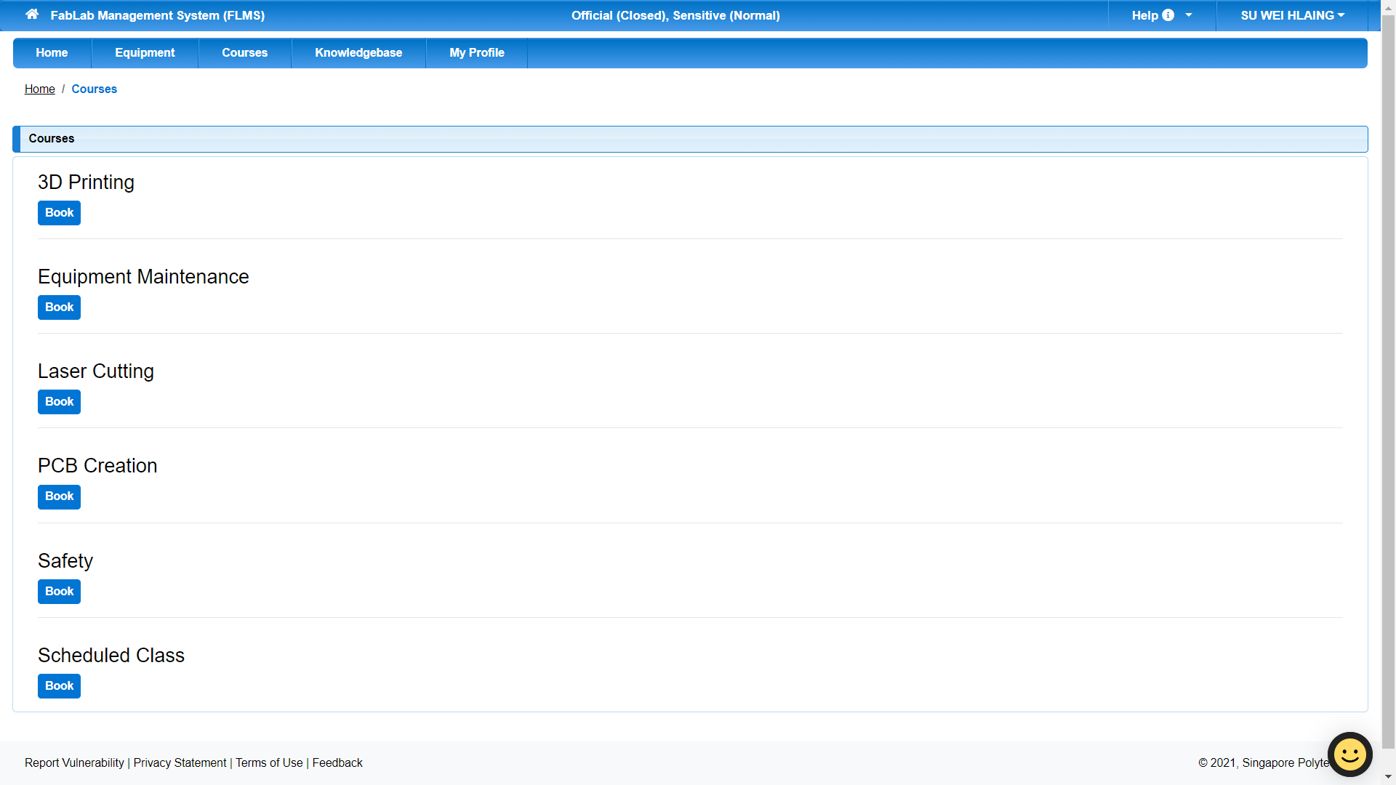
Step 2
Find the course you need to attend and click “Book”. For this step-by-step guide, we’ll be booking a “Safety” course. Note that this is only for demonstration purpose.

Slide 16
Step 3
You can see that the profile photo has changed in the details table.

